Slide 1
Module 3.1: Introduction to Machine Learning
Dennis J. Zhang
Washington University in St. Louis

Slide 2
Roadmap
Supervised learning general concepts
Supervised learning Models
K Nearest Neighbor
Decision Tree
Bootstrapping, Bagging, and Random Forest
XGBOOST

Slide 3
What is Machine Learning?
“Field of study that gives computers the ability to learn without explicitly programmed”
Different names:
Data mining
Statistical learning
Predictive Analysis
Data Science

Slide 4
Different types of Machine Learning
Supervised (Statistical) Learning
Data = (Label, Feature). Given new features, predict the label.
E.g. Email spam detector.
Unsupervised Learning
Data = Feature. Classify the data.
E.g. Topic modeling.
Reinforcement Learning
Data: a series of actions leading to a goal.
E.g., Google AlphaGo.

Slide 5
Statistical Learning

Slide 6
Introduction
Model: Y = f(X) + epsilon
Observation: (X, Y)i.
Objective: Estimate f()
Question: Why do we estimate f?
Inference: how is Y changing with X? (e.g., price and demand, schooling and wages..)
Prediction: Given Xj, predict Yj

Slide 7
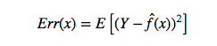
Evaluation
How do we judge the performance of one estimation?
First, let us define an error metric (loss function).
MSE:
Second, we compute this MSE on data:
Question: When you evaluate an estimation, should you look at MSE1 or MSE2?
Training Data (1, 2, …, N)
Holdout Data (N+1, …, M)
MSE1
MSE2

Slide 8
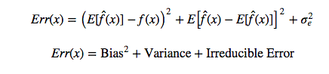
Evaluation – Variance-bias Tradeoff
MSE1
MSE2

Slide 9
Evaluation – Variance-bias Tradeoff

Slide 10
Evaluation – Usage of Data
How do we utilize this variance-bias trade-off idea?
Consider the previous problem that you have Y and X. And you know Y is a polynomial of X. However, you do not know the actual largest degree.
Hyper-parameter: The largest number of degree.
Parameter: The coefficient in front of each power of X.
Divide the data into: training, validation and testing.
Using training data to find the actual coefficient with a given highest power.
Using validation data to find the best highest power
Using testing data to report the final result.
Question: Data is valuable. How do we use less data to achieve this?

Slide 11
Evaluation – Cross-validation
Cross validation is a model validation technique for accessing how results of a statistical model will generalize to an independent data set.
Cross validation combines the validation and training datasets.
It provides same level of statistical power in model selection.
It also improves the amount of data used to train the model.

Slide 12
Evaluation – K-fold Cross-validation
Theoretical guarantee and relation to AIC/BIC (in linear Gaussian case): Nishi 1984

Slide 13
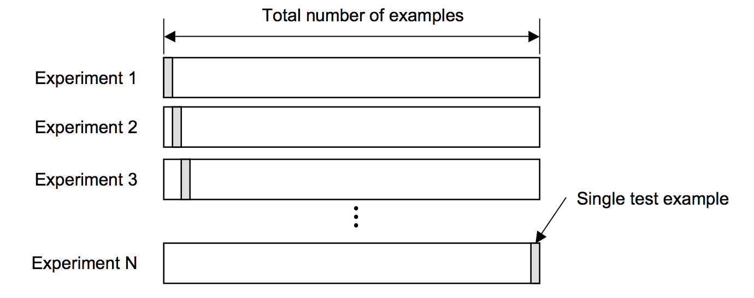
Leave-one-out Cross Validation
Leave-one-out is the degenerate case of K-Fold Cross Validation, where K is chosen as the total number of examples:
For a data set with N samples, perform N times of the experiment
For each experiment, train the model on N-1 data points and perform testing on the remaining one sample
The final error is estimated as the average error over all experiments.

Slide 14
What is the optimal K?
With a large number of folds
The bias of the true error rate estimator will be small (the estimator will be very accurate)
The variance of the true error rate estimator will be large
The computational time will be very large as well (many experiments)
With a small number of folds
The number of experiments and, therefore, computation time are reduced
The variance of the estimator will be small
The bias of the estimator will be large (conservative or higher than the true error rate)
In practice, the choice of the number of folds depends on the size of the dataset
For large datasets, even 3-Fold Cross Validation will be quite accurate
For very sparse datasets, we may have to use leave-one-out in order to train on as many examples as possible
A common choice for K-Fold Cross Validation is K=10
Notes:
Large K -> close to full sample -> close to true model performance -> lower bias
Large K -> all the K training sets are largely correlated -> K correlated test errors -> larger variance.

Slide 15
Other model validation methods
The best way to validate a model is to hold a large set of testing set.
This is often not possible – data is valuable
Cross-validation
Another way to solve the testing standard error problems is to find the mapping function between training and testing standard errors and adjust the in-sample error to reflect the out-of-sample errors.
Adjusted R-squared for linear regression
AIC
BIC

Slide 16
Other model validation methods

Slide 17
CV vs. other methods
For linear regression, BIC is asymptotically similar to CV.
Advantage of CV:
It is the closest to the optimal scenario (large testing sample)
It does not require close-form equation of standard errors.
Even for models that do not have likelihood function (i.e., EM method), it is well defined.
Disadvantage of CV:
It is computational inefficient (this is no longer a disadvantage)

Slide 18
Linear Regression – The Model
The model has a deterministic and a probabilistic components
House
Cost
Building a house costs about
$75 per square foot.
House cost = 25000 + 75(Size)
Most lots sell
for $25,000
House size

Slide 19
Linear Regression – The Model
However, house cost vary even among same size houses!
Since cost behave unpredictably, we add a random component.
House
Cost
Most lots sell
for $25,000
House cost = 25000 + 75(Size)
+ ε
House size

Slide 20
Linear Regression – The Model
The first order linear model
y = dependent variable
x = independent variable
β₀ = y-intercept
β₁ = slope of the line
ε = error variable
β₀ and β₁ are unknown population parameters, therefore are estimated
from the data.
y
Rise
β₁ = Rise/Run
β₀
Run

Slide 21
Estimating the coefficients
The estimates are determined by
drawing a sample from the population of interest,
calculating sample statistics.
producing a straight line that cuts into the data.
y
w
Question: What should be considered a good line?
w
w
w
w
w w w w
w
w w
w w
w
x

Slide 22
The Least Squares (Regression) Line
A good line is one that minimizes the sum of squared differences between the points and the line.
Sum of squared differences =
(2 - 1)² +
(4 - 2)² +
(1.5 - 3)² +
(3.2 - 4)² = 6.89
Sum of squared differences =
(2 -2.5)² +
(4 - 2.5)² +
(1.5 - 2.5)² +
(3.2 - 2.5)² = 3.99
Let us compare two lines
4
(2,4)
w
The second line is horizontal
3
w
(4,3.2)
2.5
2
w
(1,2)
(3,1.5)
w
The smaller the sum of
squared differences
the better the fit of the
line to the data.
1
1
2
3
4

Slide 23
The Estimated Coefficients
Alternate formula for the slope b₁
To calculate the estimates of the slope and intercept of the least squares line , use the formulas:
The regression equation that estimates the equation of the first order linear model is:

